Slide 1
Executive Product Sales Analytics Data visualization with Tableau project
Sunil Kumar Mano
GCD - June '08 batch, INSAID
Email : sunilkumarm.182@gmail.com

Slide 2
Introduction
A sales organization need to build competitive advantage by understanding the big picture. Sales KPIs, including sales performance, cost-to-revenue ratios and quota attainment are the key metrics needed to create that big picture. With a powerful business intelligence and analytics platform like Tableau, the company can leverage all of its data from distributed databases and build actionable insights quickly and consistently.
In this project, we will:
Understand the organization data leads to deeper insights
A single source of truth helps to get the team on the same page
Create interactive visualizations bring sales reporting to the company
Shared dashboards support collaboration across organization

Slide 3
Business problem statement
The Retail Organization is facing difficulty to gather information from various departments inside it and making necessary decisions.
The Retail Organization is having below departments.
Sales Department
Finance Department
Warehouse Department
Decision makers need one centralized dashboard where there can get the updates from all the departments up-to-date at a one stretch which help them in making necessary decisions.
The solution for the problem is to construct a Tableau Dashboard and host it in a centralized server where the stake holders can access it in any of the devices.

Slide 4
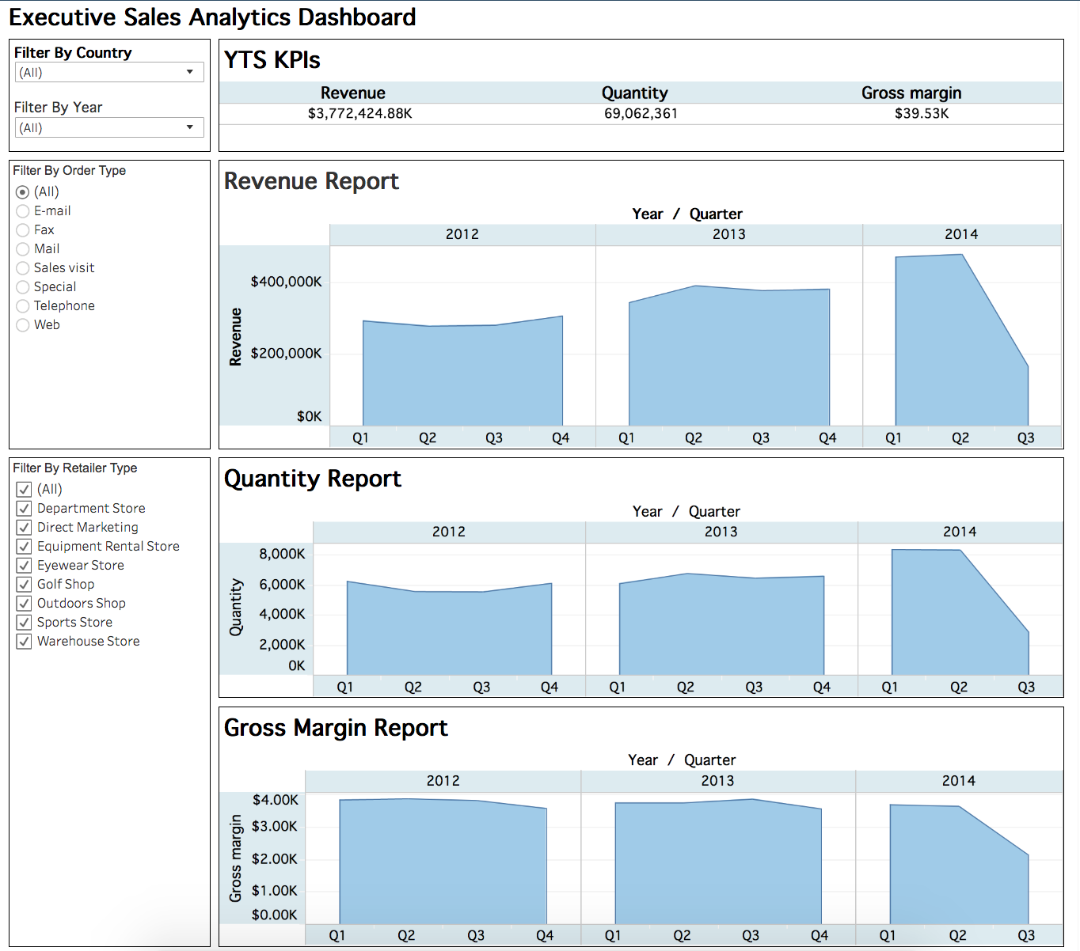
Business Problem Solution
Get the report of Key Performance Indicators(KPIs) for a Country based on a certain year.
Extract the Revenue, Quantity of sales and Gross Margin report for each quarters for every year based on the type of order received and type of the retailer.
Get the revenue for each quarters based on the product category.
Get the KPI report based on the product type and product line.
Visualize the sales performance in a map for each region based on the country.

Slide 5
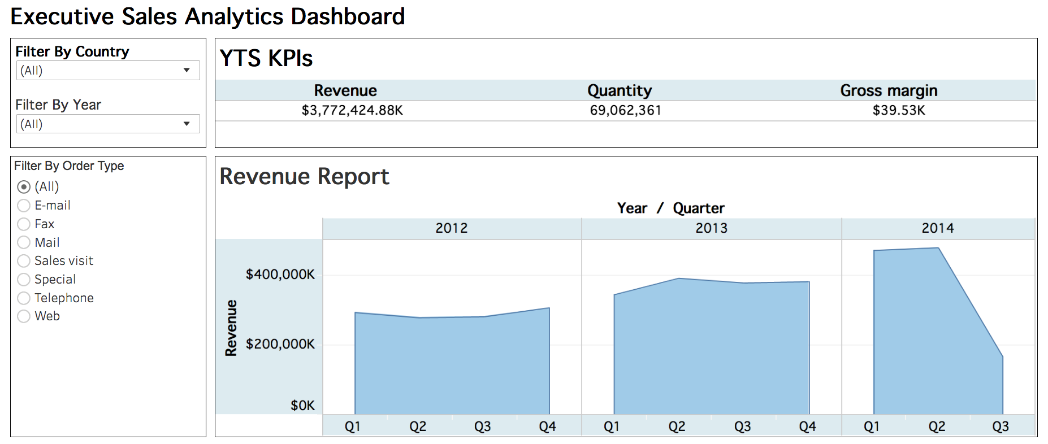
KPIs Report

Slide 6
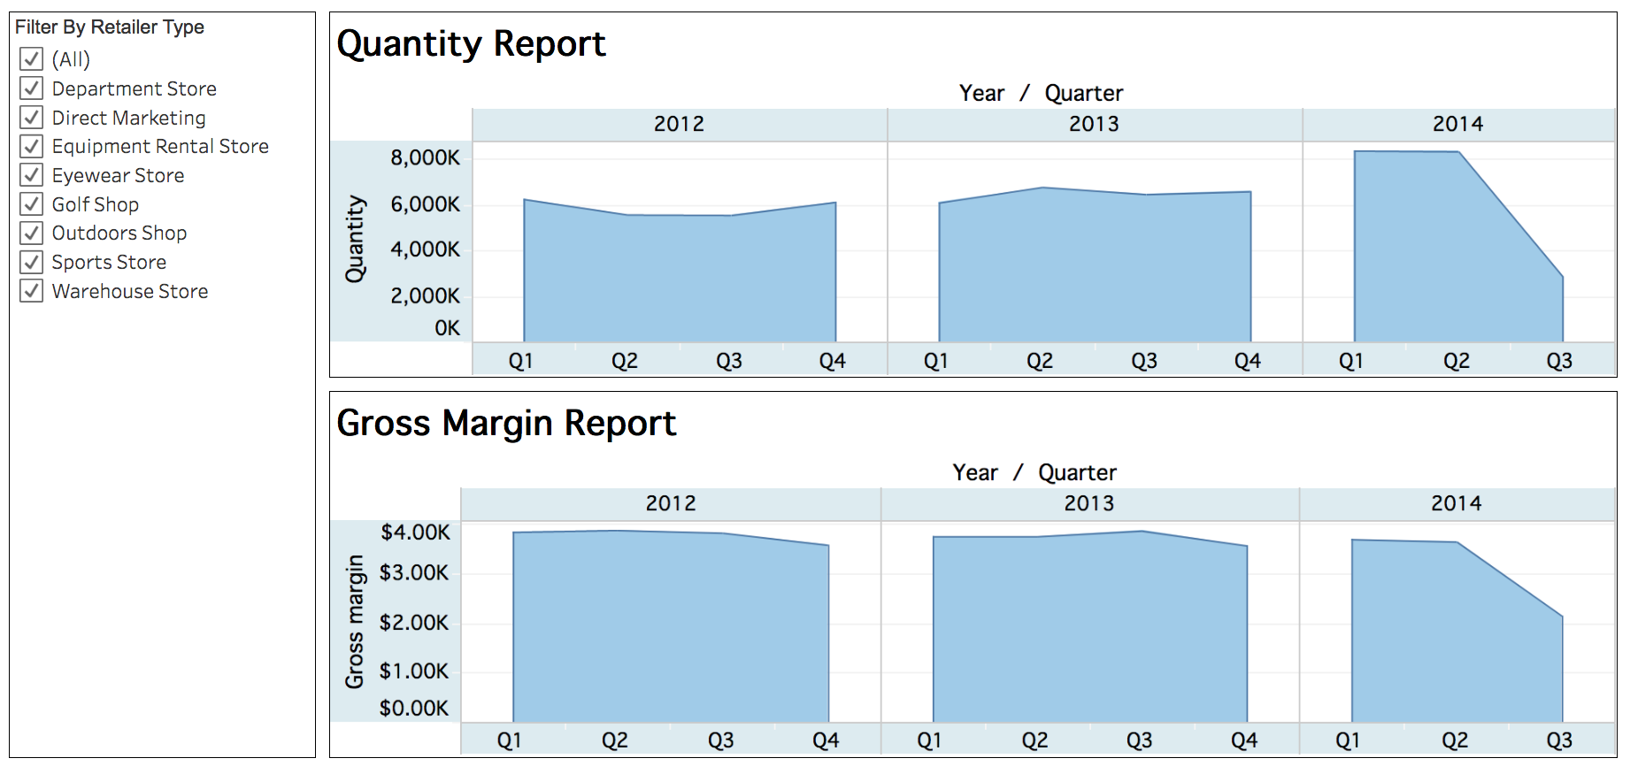
Quantity and Gross Margin Report

Slide 7
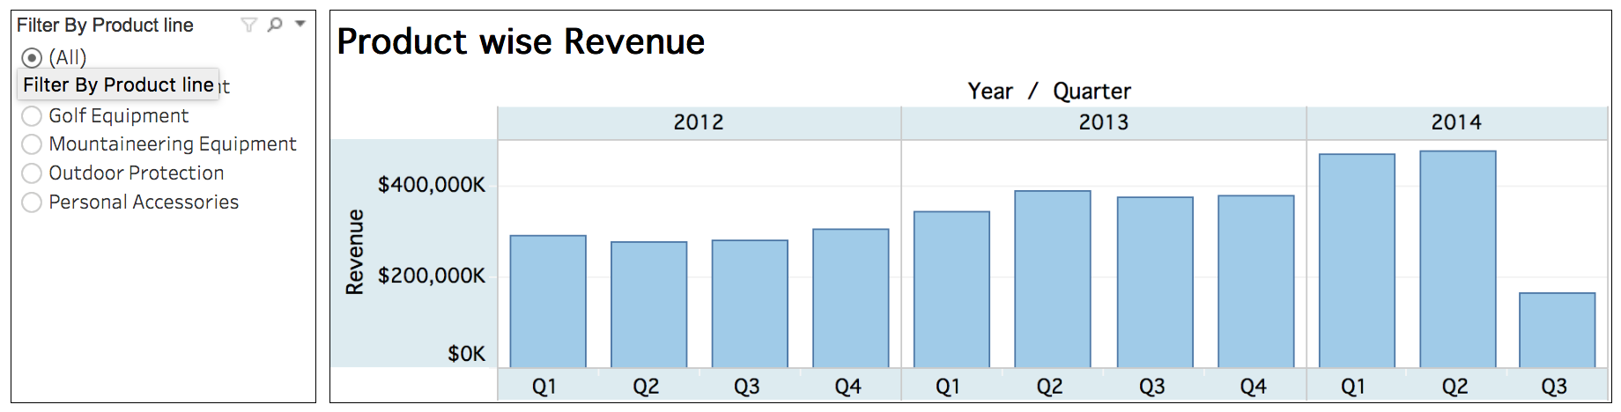
Product wise revenue report

Slide 8
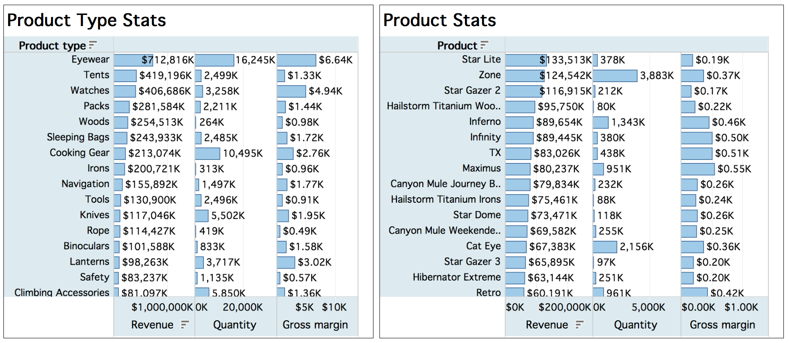
KPIs based product type and product stats

Slide 9
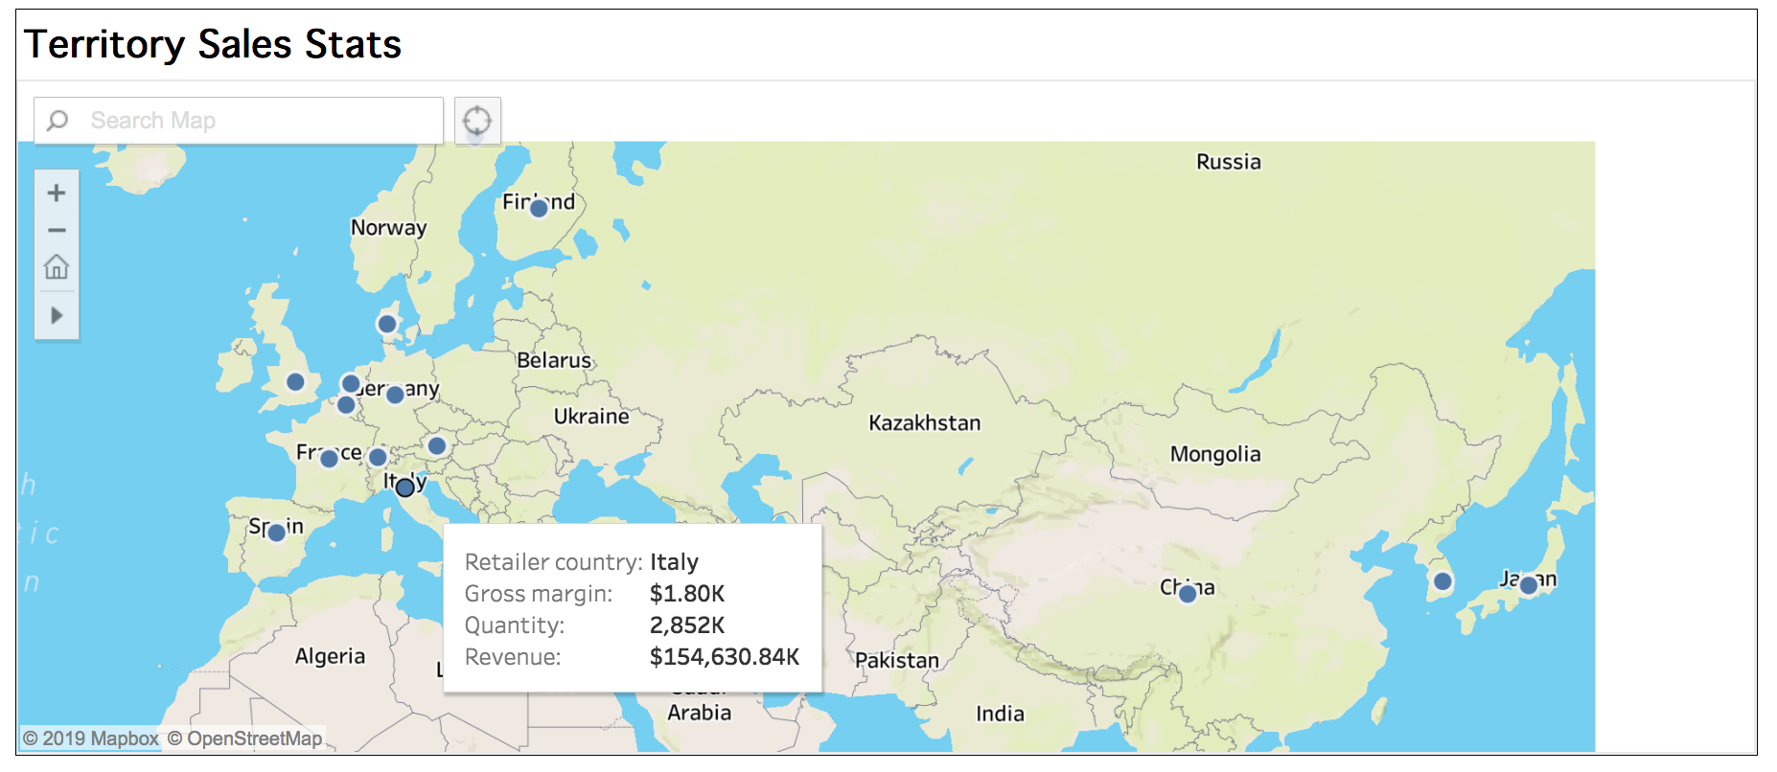
Map with all Kpis on a pointer overlay

Slide 10
Conclusion
Based on Visualizations, we have solved the organizations problem by providing a solution with a centralized dashboard.
With this dashboard organization can get the overall picture of Key performance indicators at Year to Date and make necessary decisions without any extra efforts or softwares.
Mainly as the dashboard is hosted in the distributed environment, decision makers can access it by clicking on the below URL in a browser with an internet connection in any of the hand held digital devices like mobile, laptops, iPads etc..
https://public.tableau.com/profile/sunil.kumar.mano#!/vizhome/ProductSalesAnalyticsProject/ExecutiveSalesAnalyticsDashboard

